Slide 1
CONVENOR. . David Robinson
WEBSITE . . . . www.live.org.au
CONTACT . . . 0407 585 808
EMAIL . . . . . . david.robinson@live.org.au

Slide 2
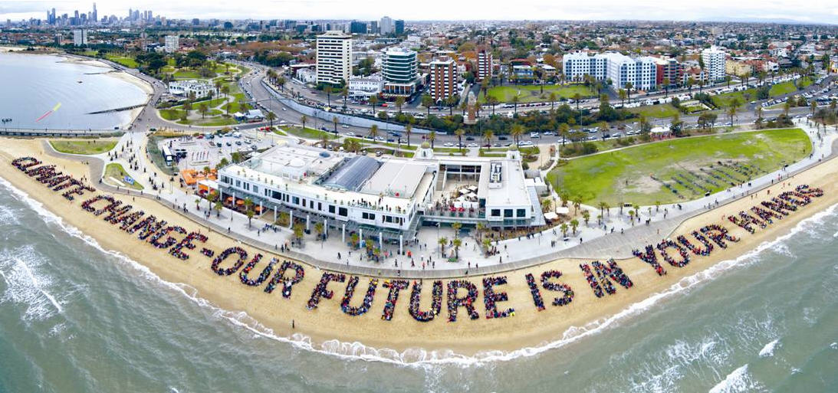
HUMAN SIGN

Slide 3
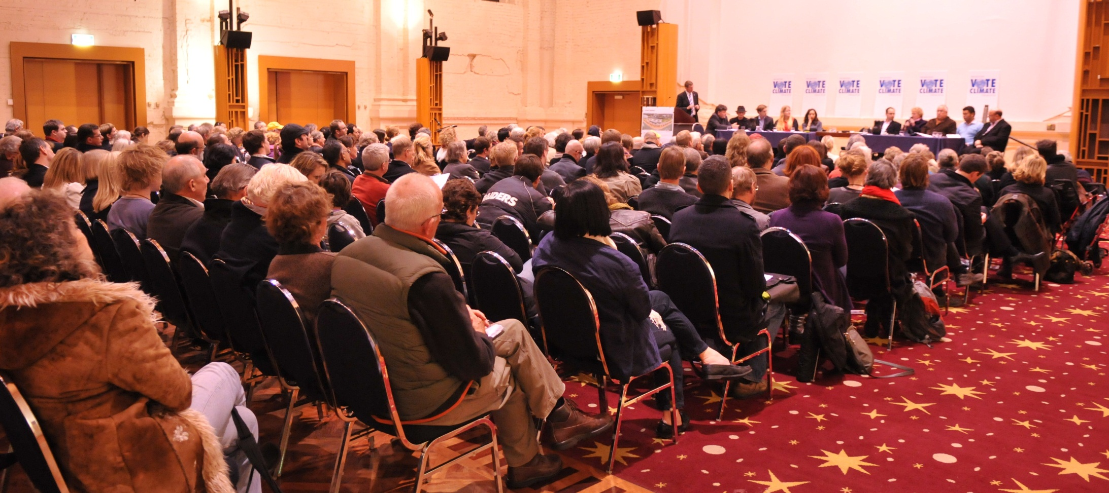
POLITICAL FORUMS

Slide 4
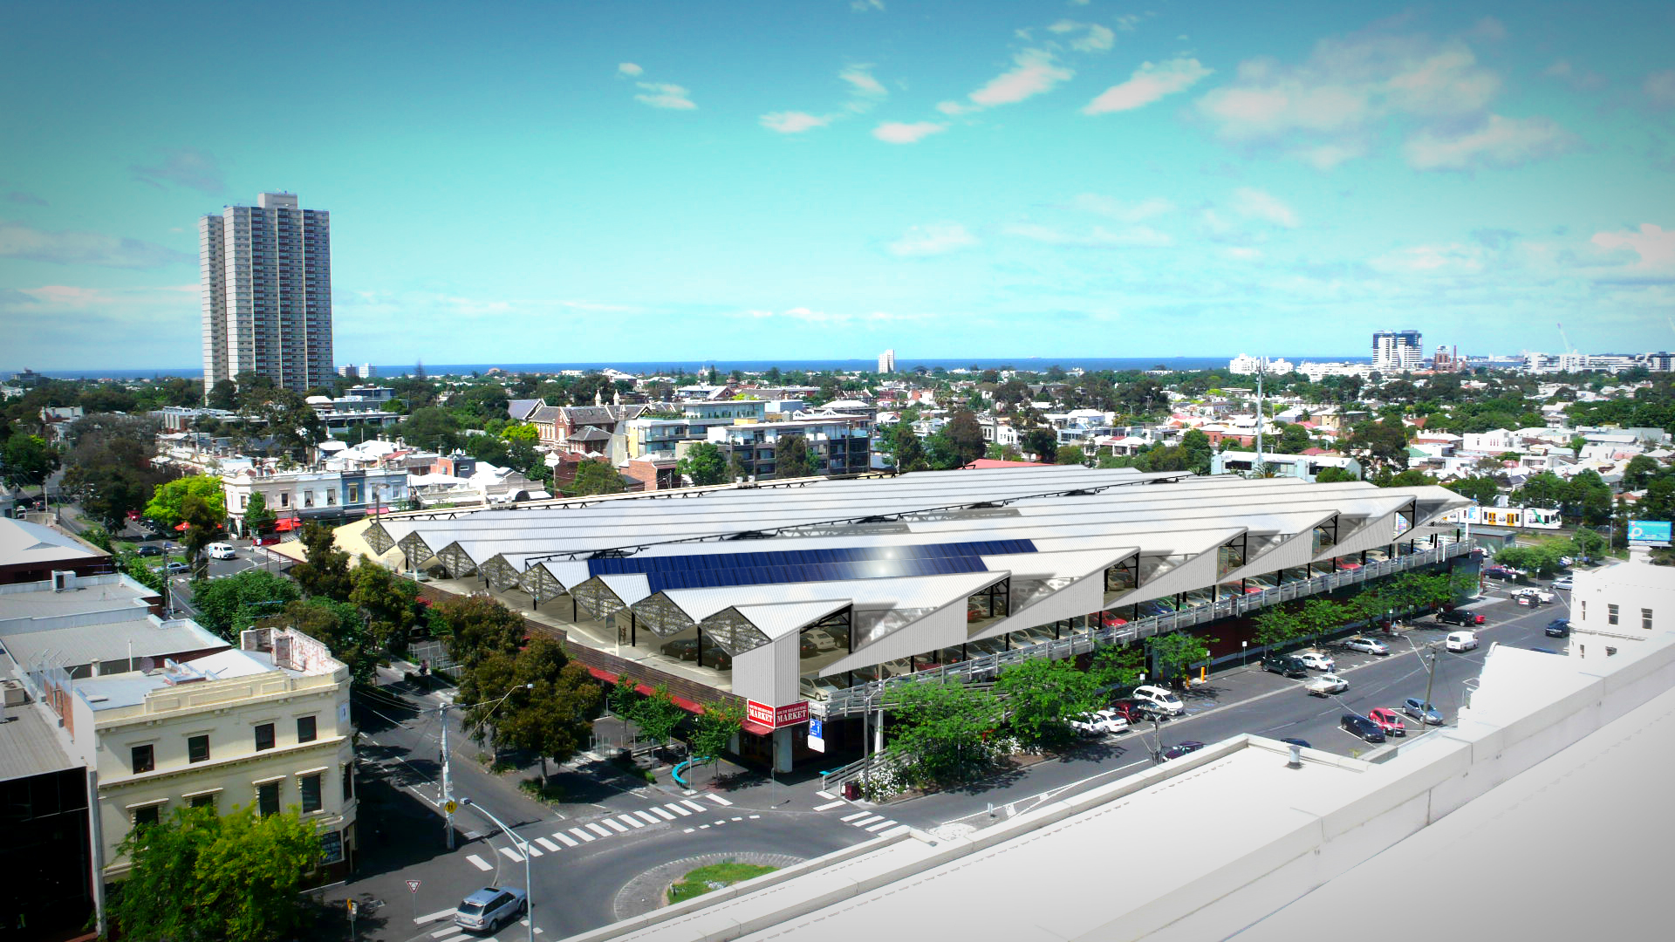
COMMUNITY SOLAR

Slide 5
CONVENOR. . David Robinson
WEBSITE . . . . www.live.org.au
CONTACT . . . 0407 585 808
EMAIL . . . . . . david.robinson@live.org.au

