Slide 1
EcoCentre

Slide 7
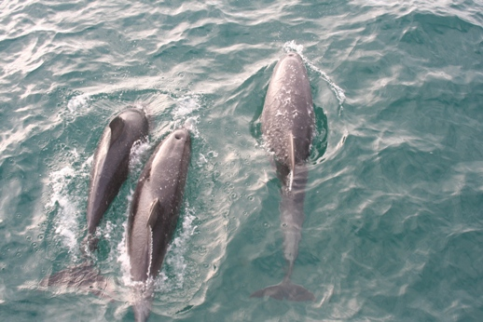

Slide 8
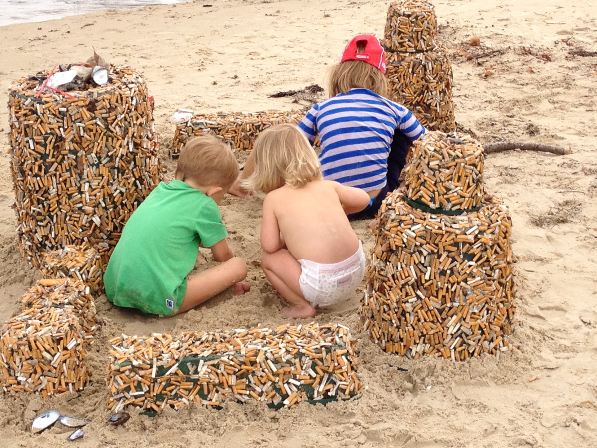

Slide 14
Open for ideas

